Slide 1
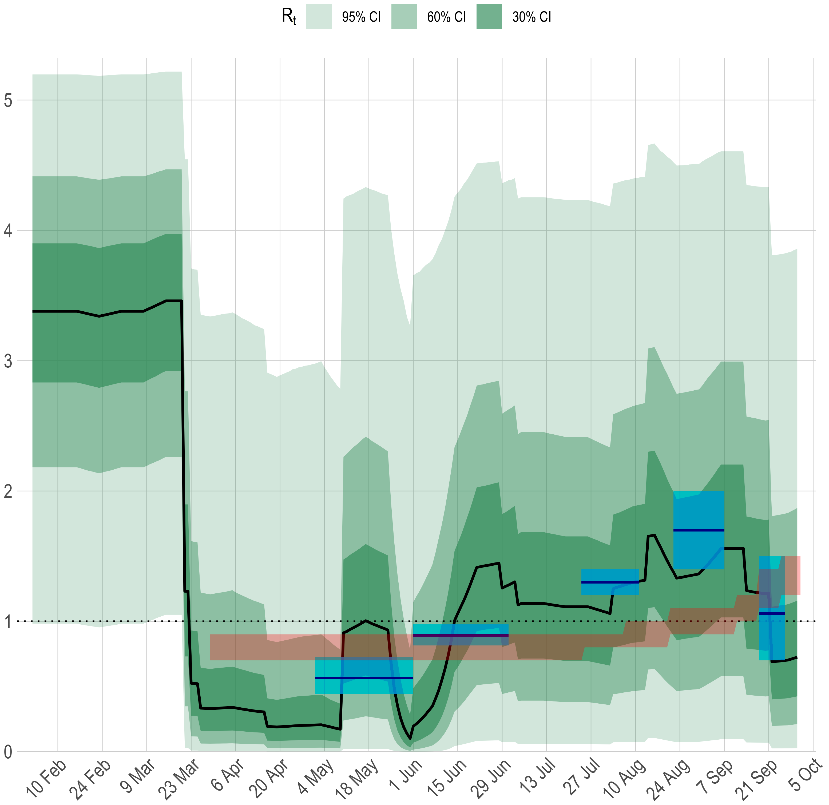
REACT result
ONS result

Slide 2
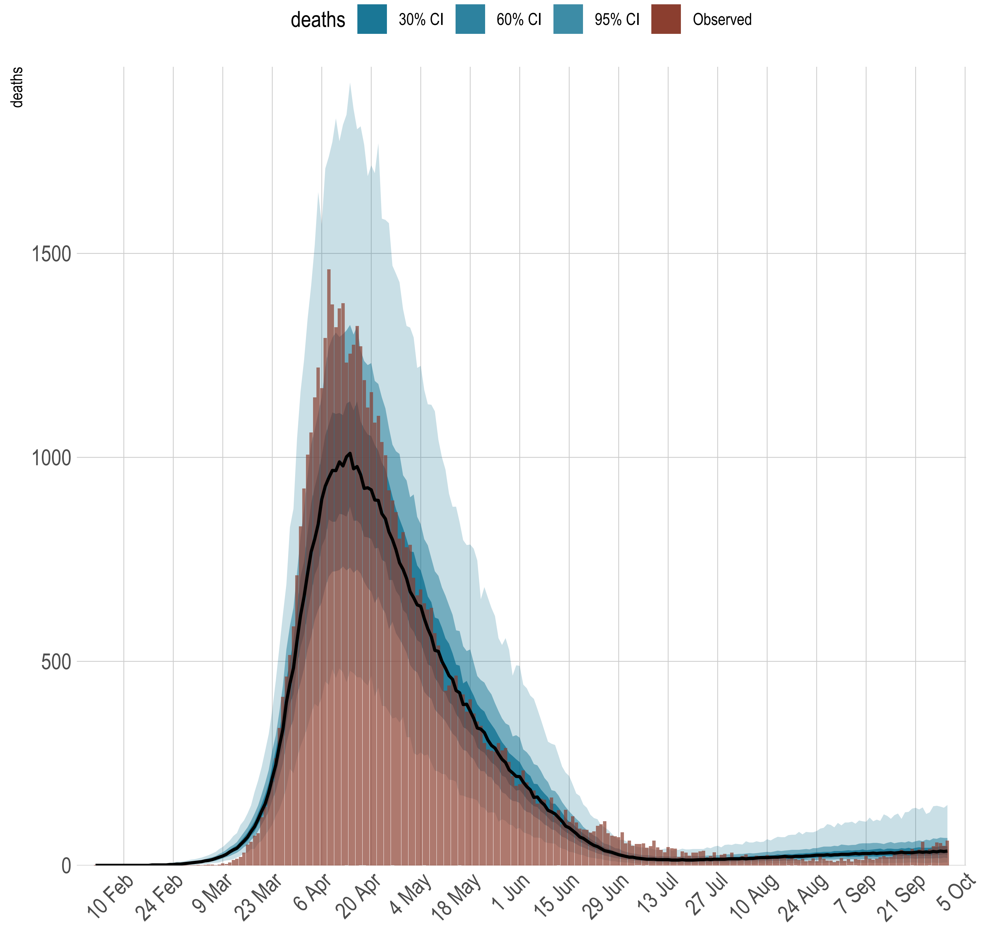

Slide 3
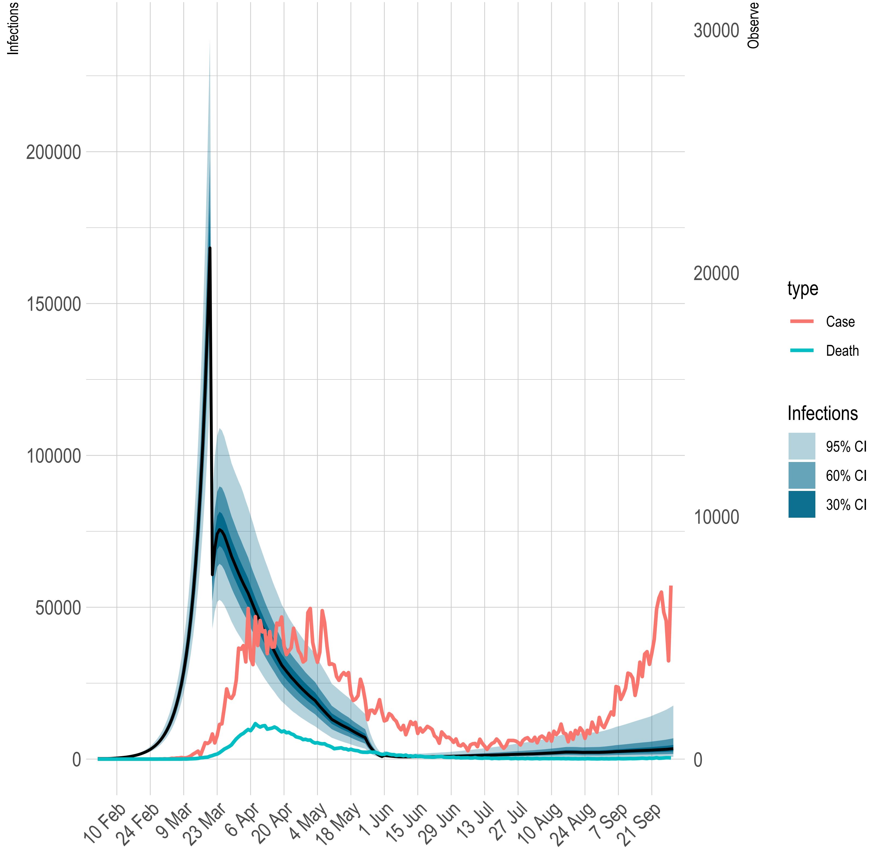

Slide 4
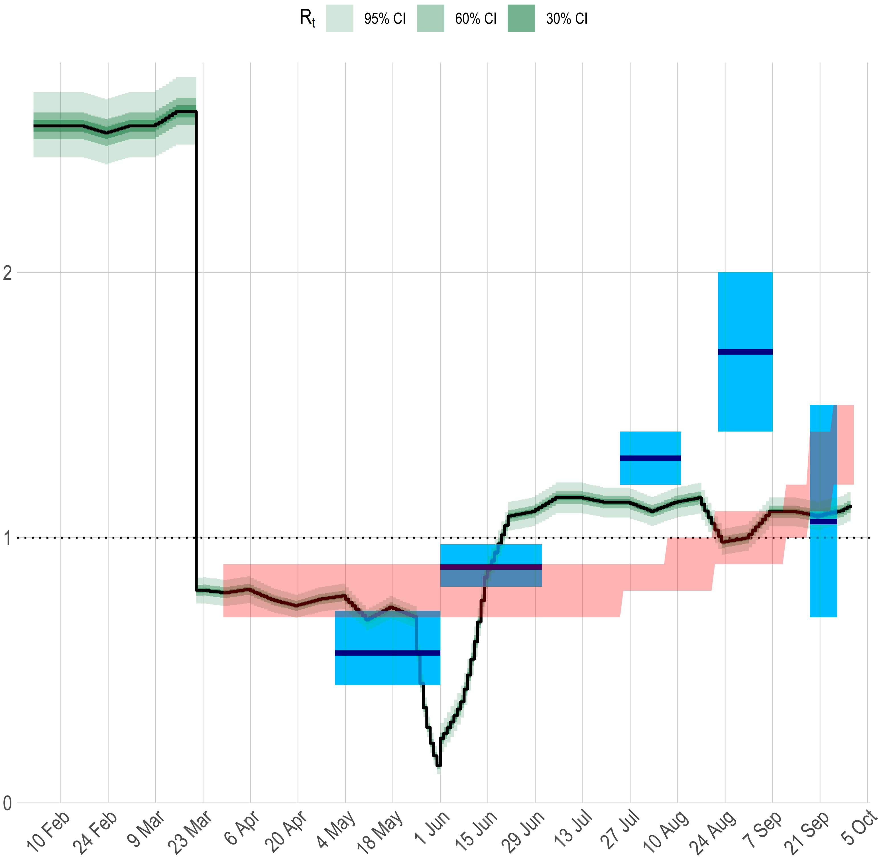
REACT result
ONS result

Slide 5
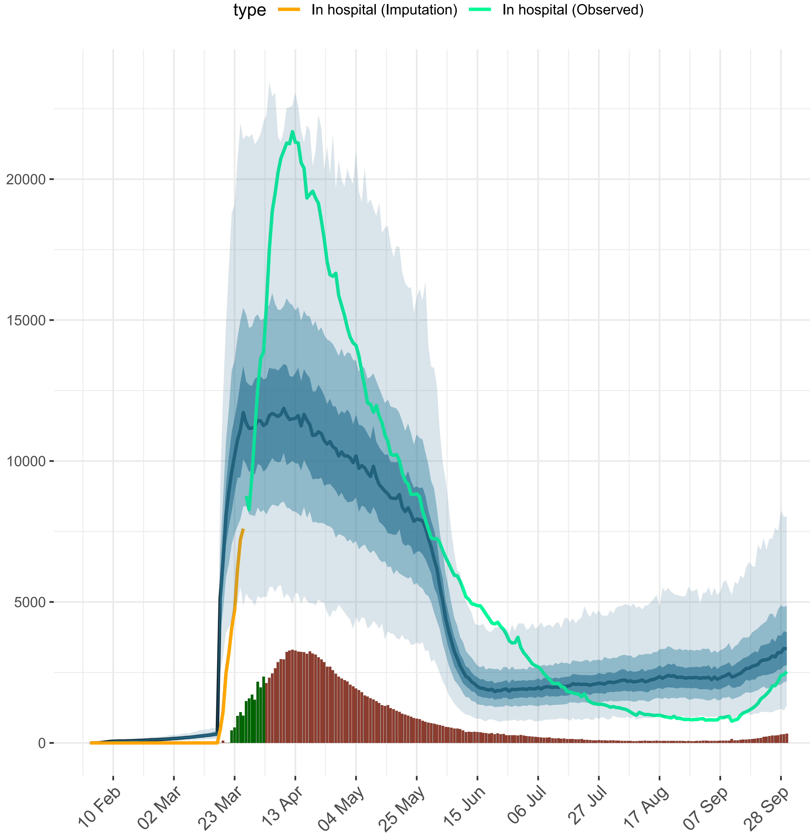

Imputation

Slide 6
REACT result
ONS result

Slide 7
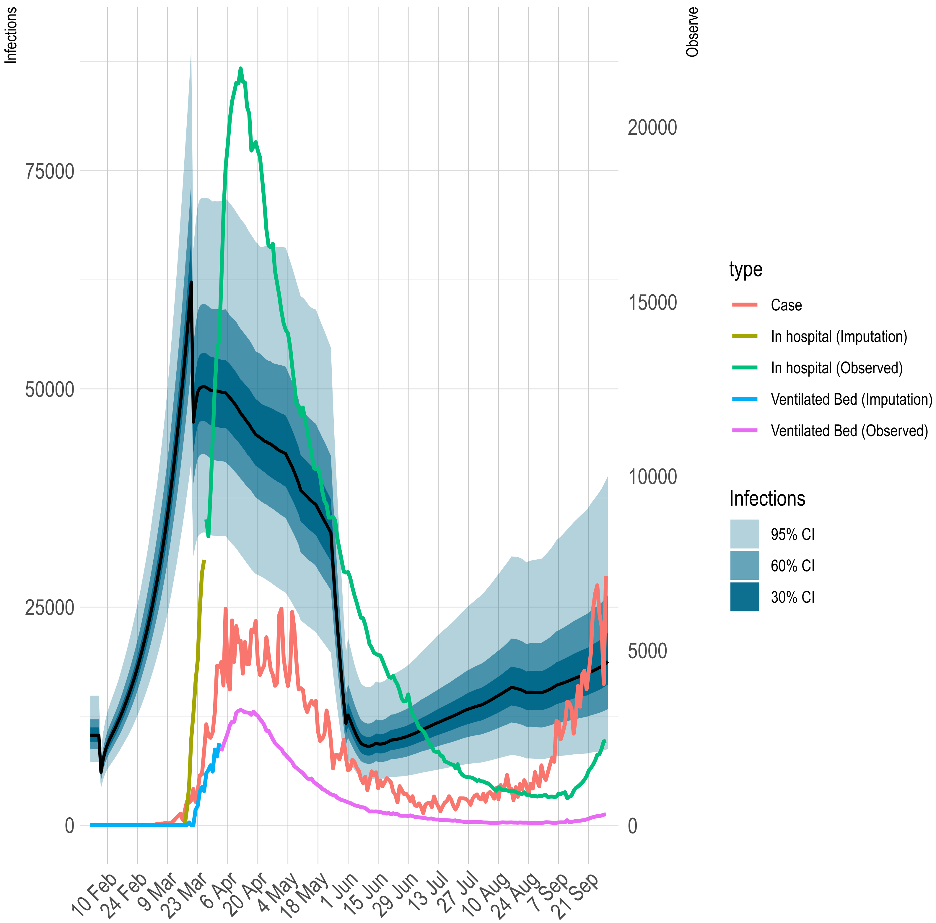

Slide 8
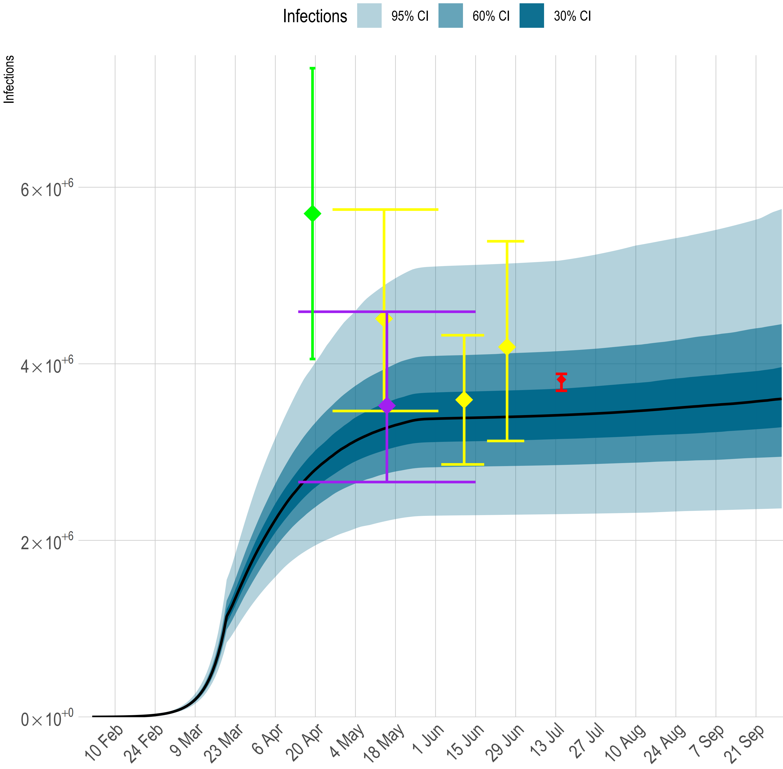
REACT group
ONS
Oxford area
Great Glasgow area

Slide 9
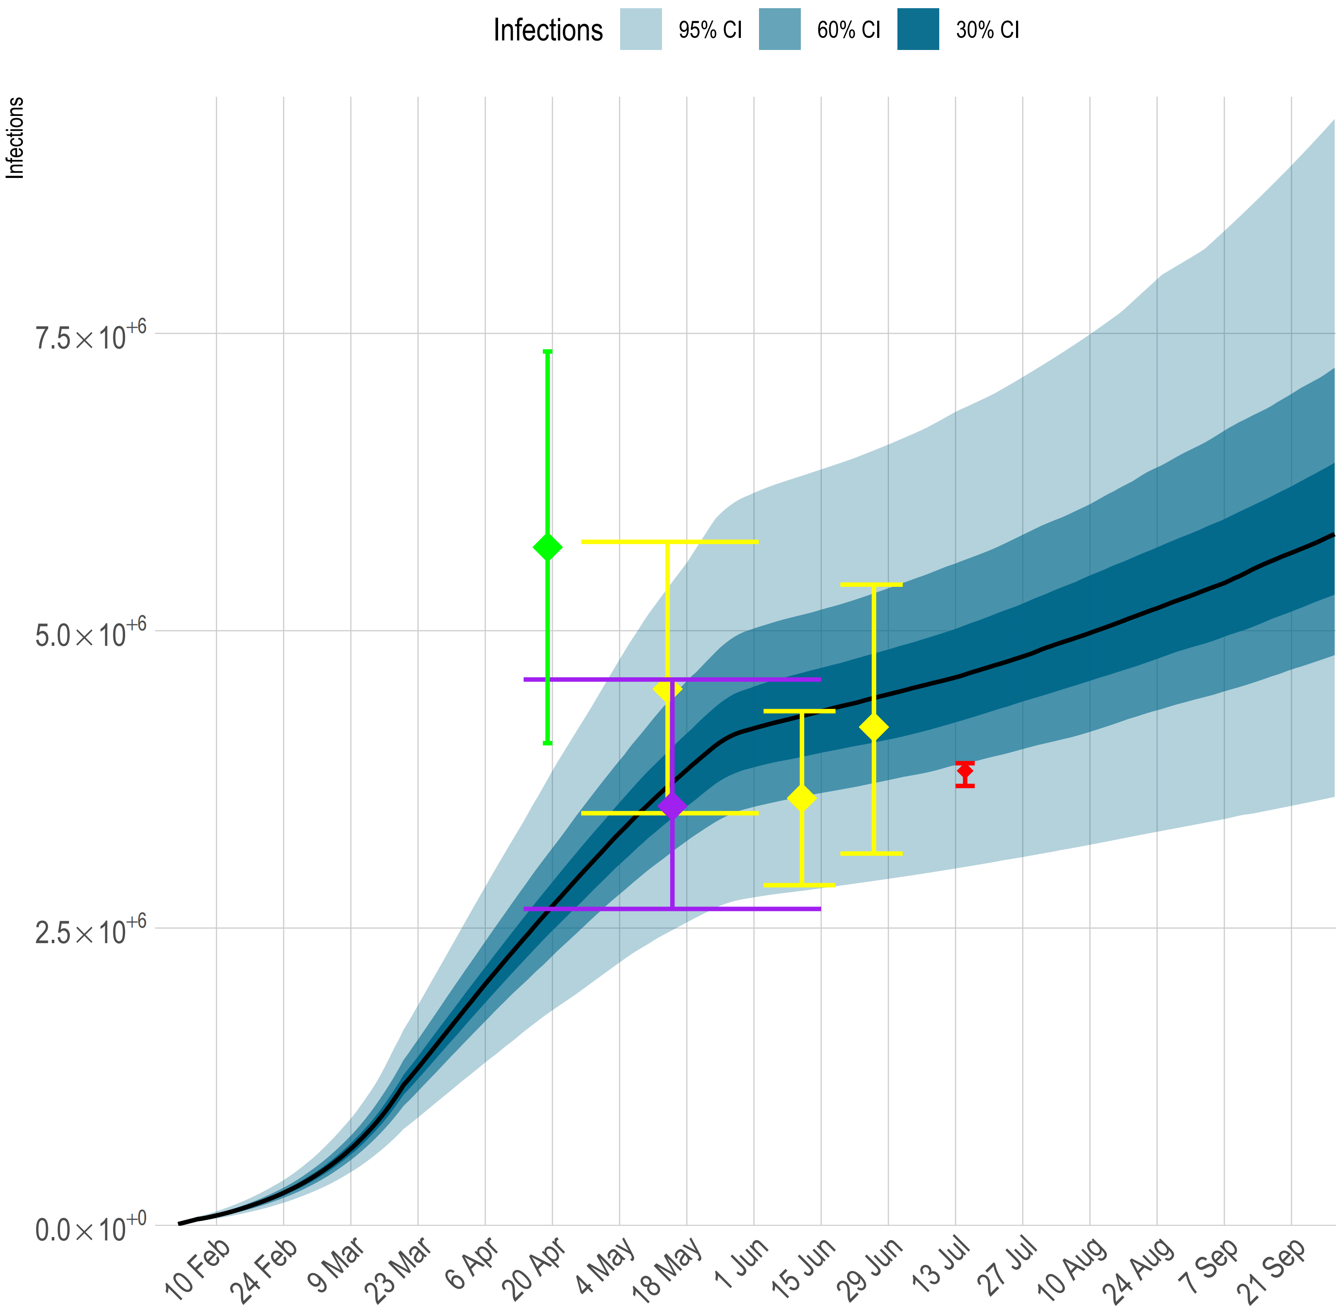
REACT group
ONS
Oxford area
Great Glasgow area

Slide 10
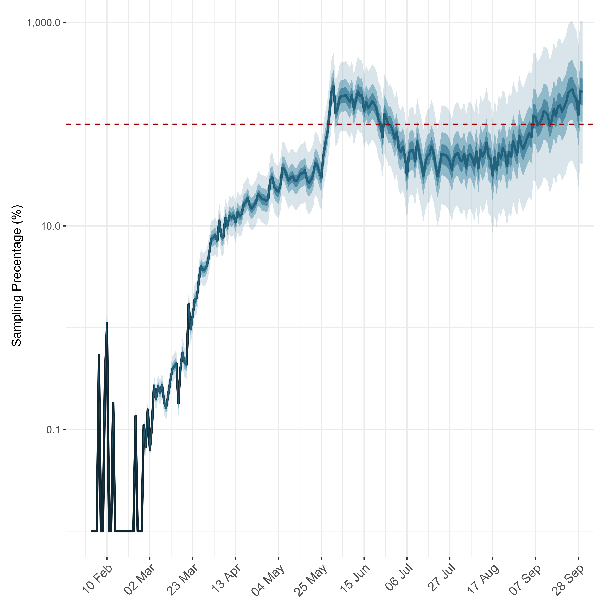

Slide 11
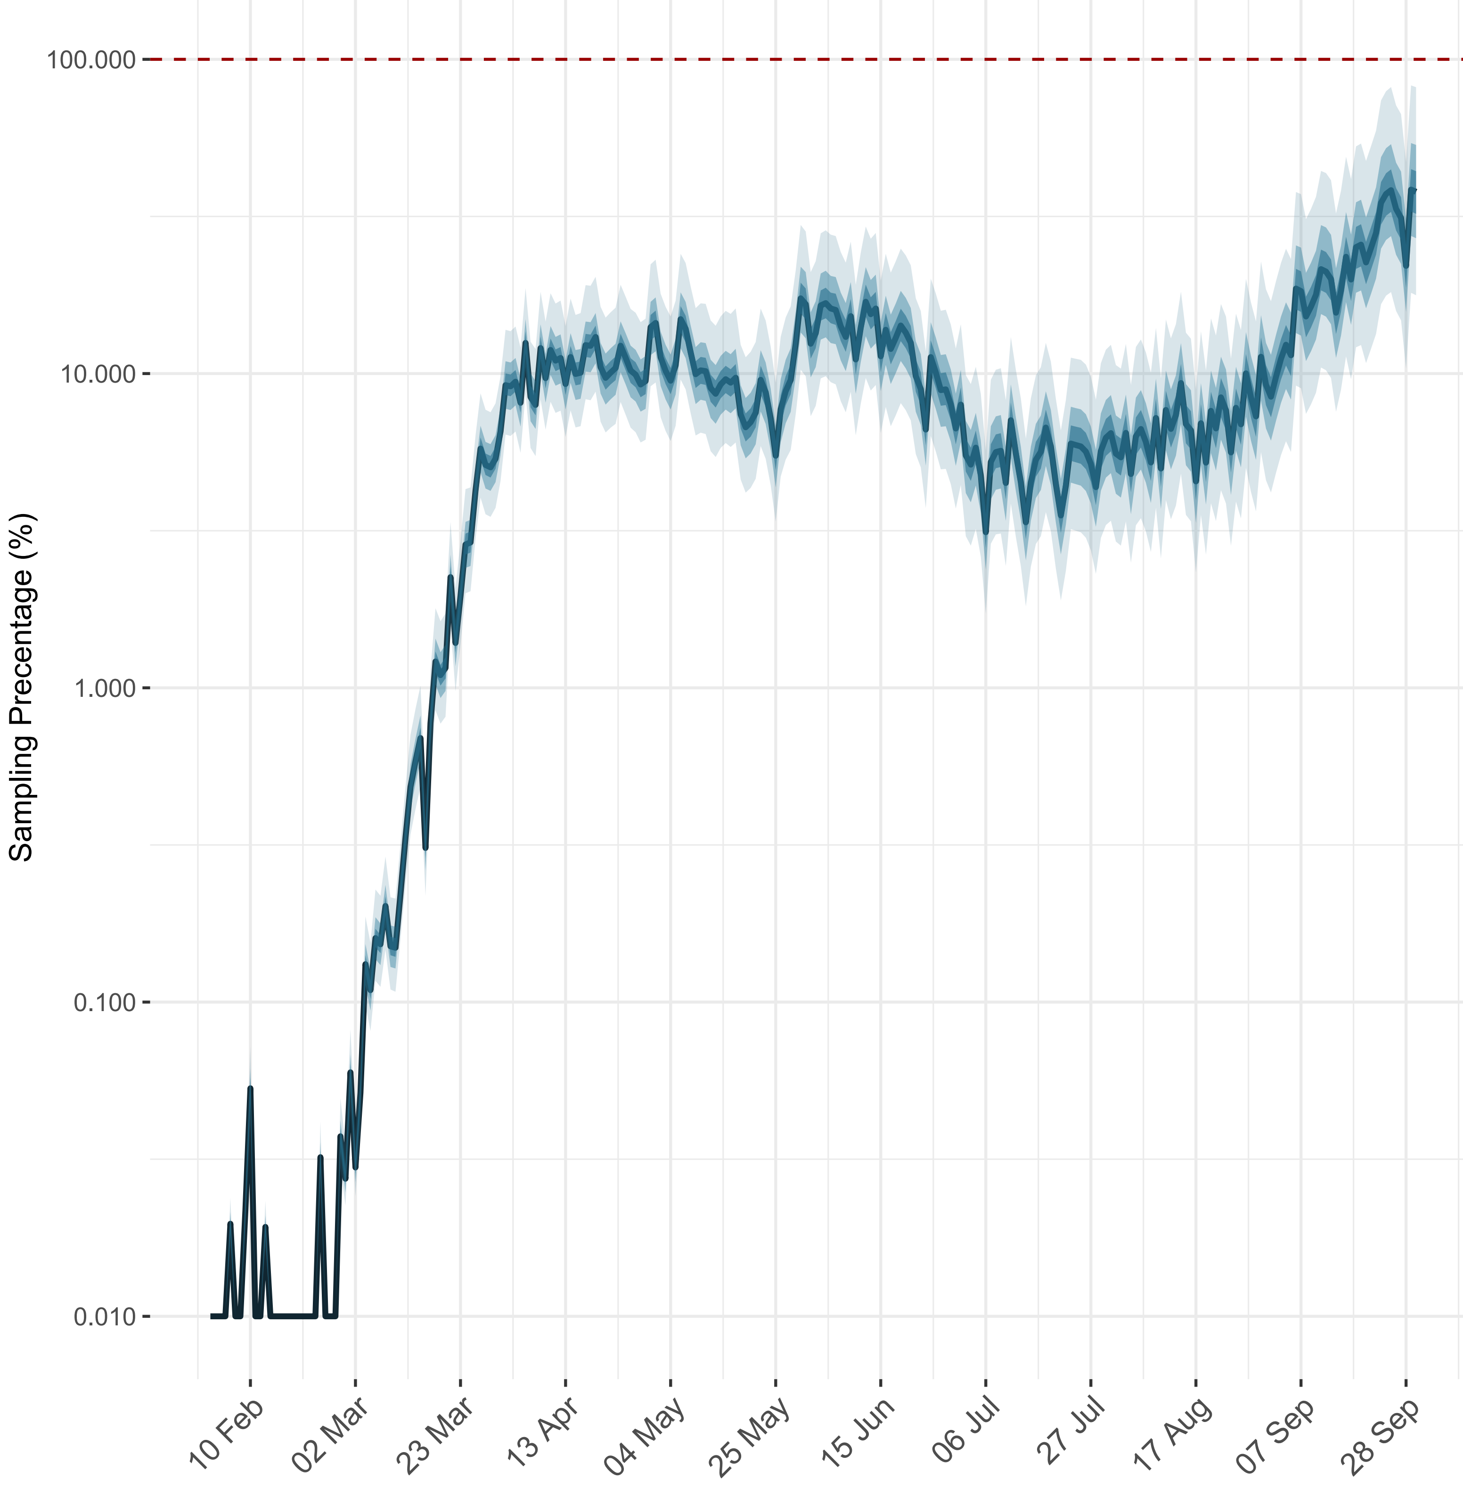

Slide 12
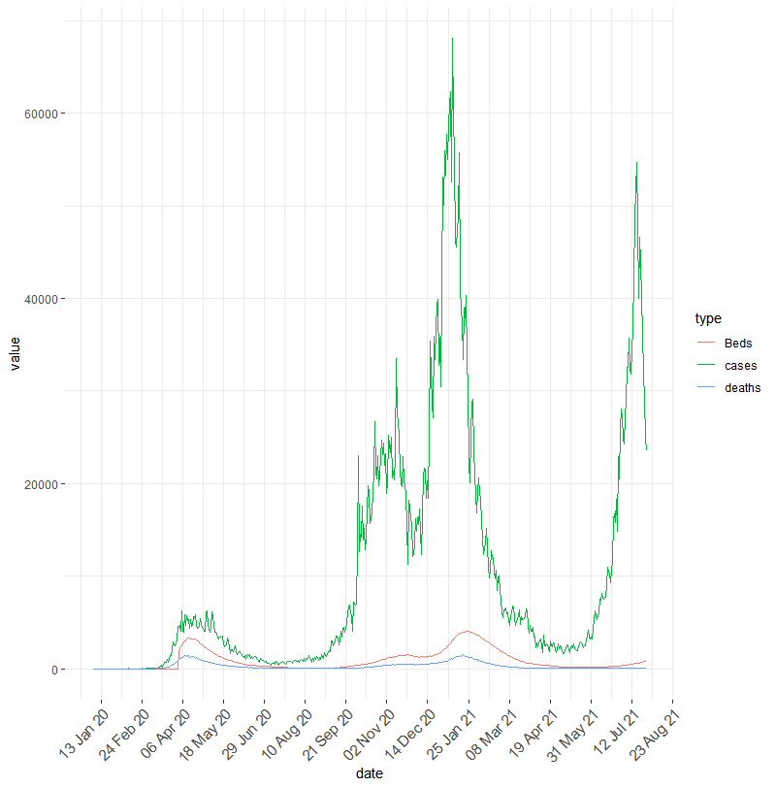

Slide 13
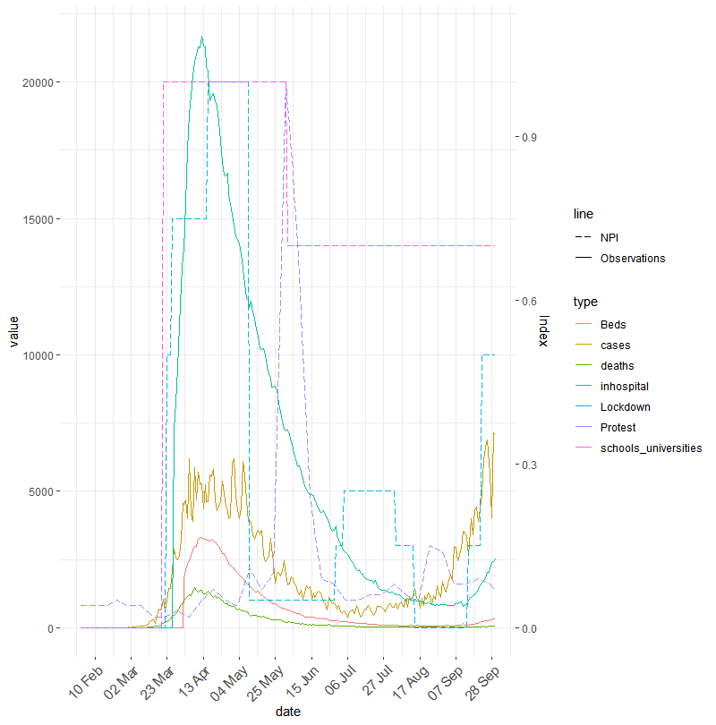

Slide 14
REACT result
ONS result

Slide 16
REACT group
ONS
Oxford area
Great Glasgow area

